Slide 1
Victron Global Remote
Victron Ethernet Remote

Slide 2
Contents
System overview diagrams
Detailed connection schematics
Examples of Text messages (SMS)
vrm.victronenergy.com: free online portal
Configuring GPRS
VGR Configure software
Remote VEConfigure

Slide 3
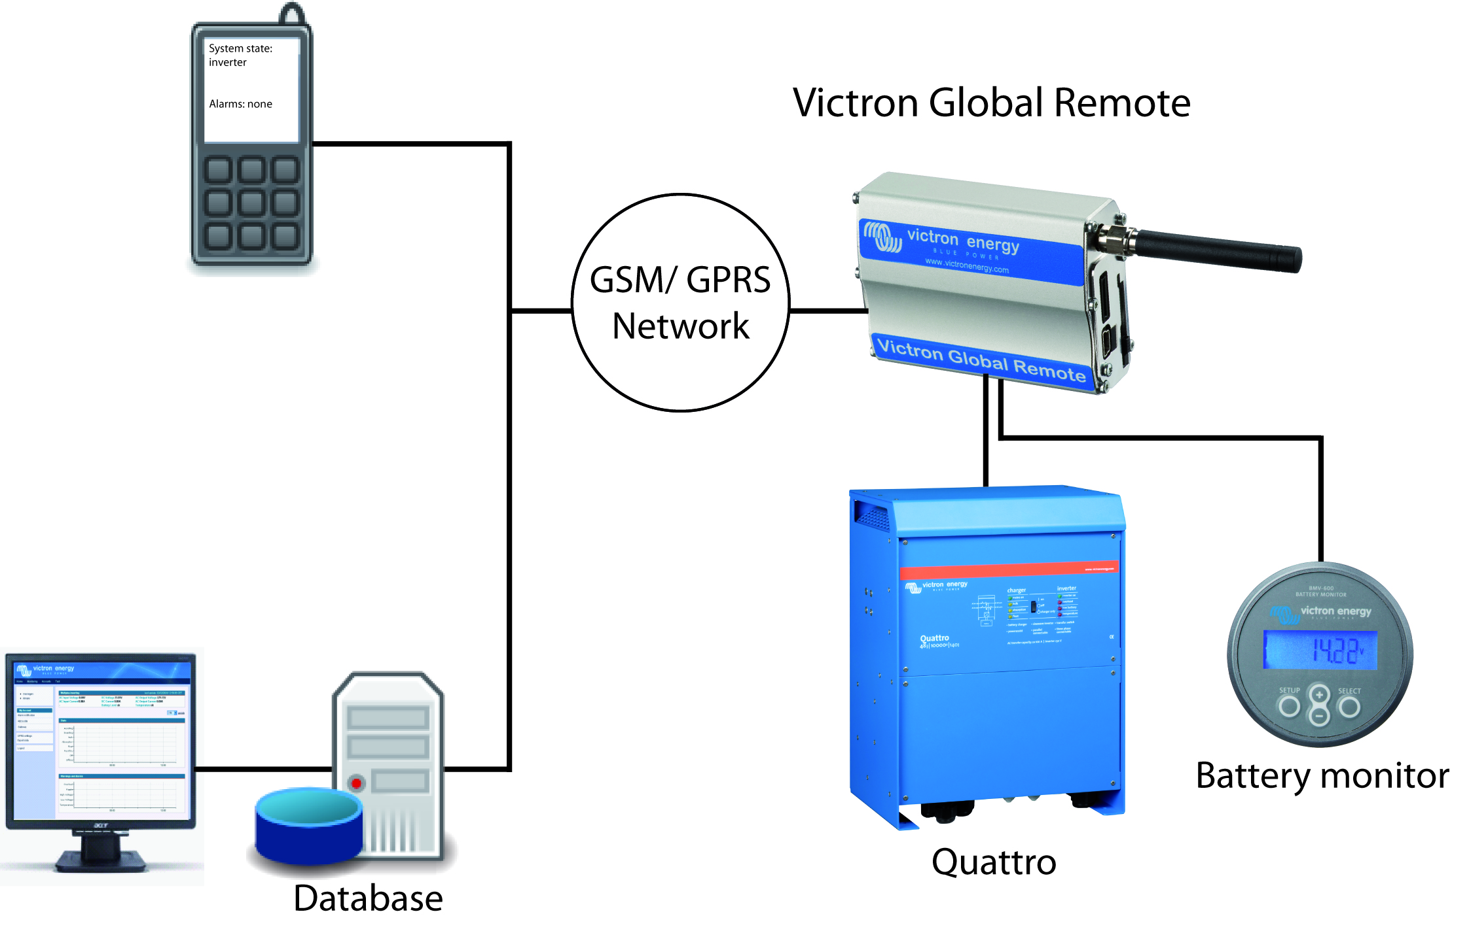
Overview - Victron Global Remote

Slide 4
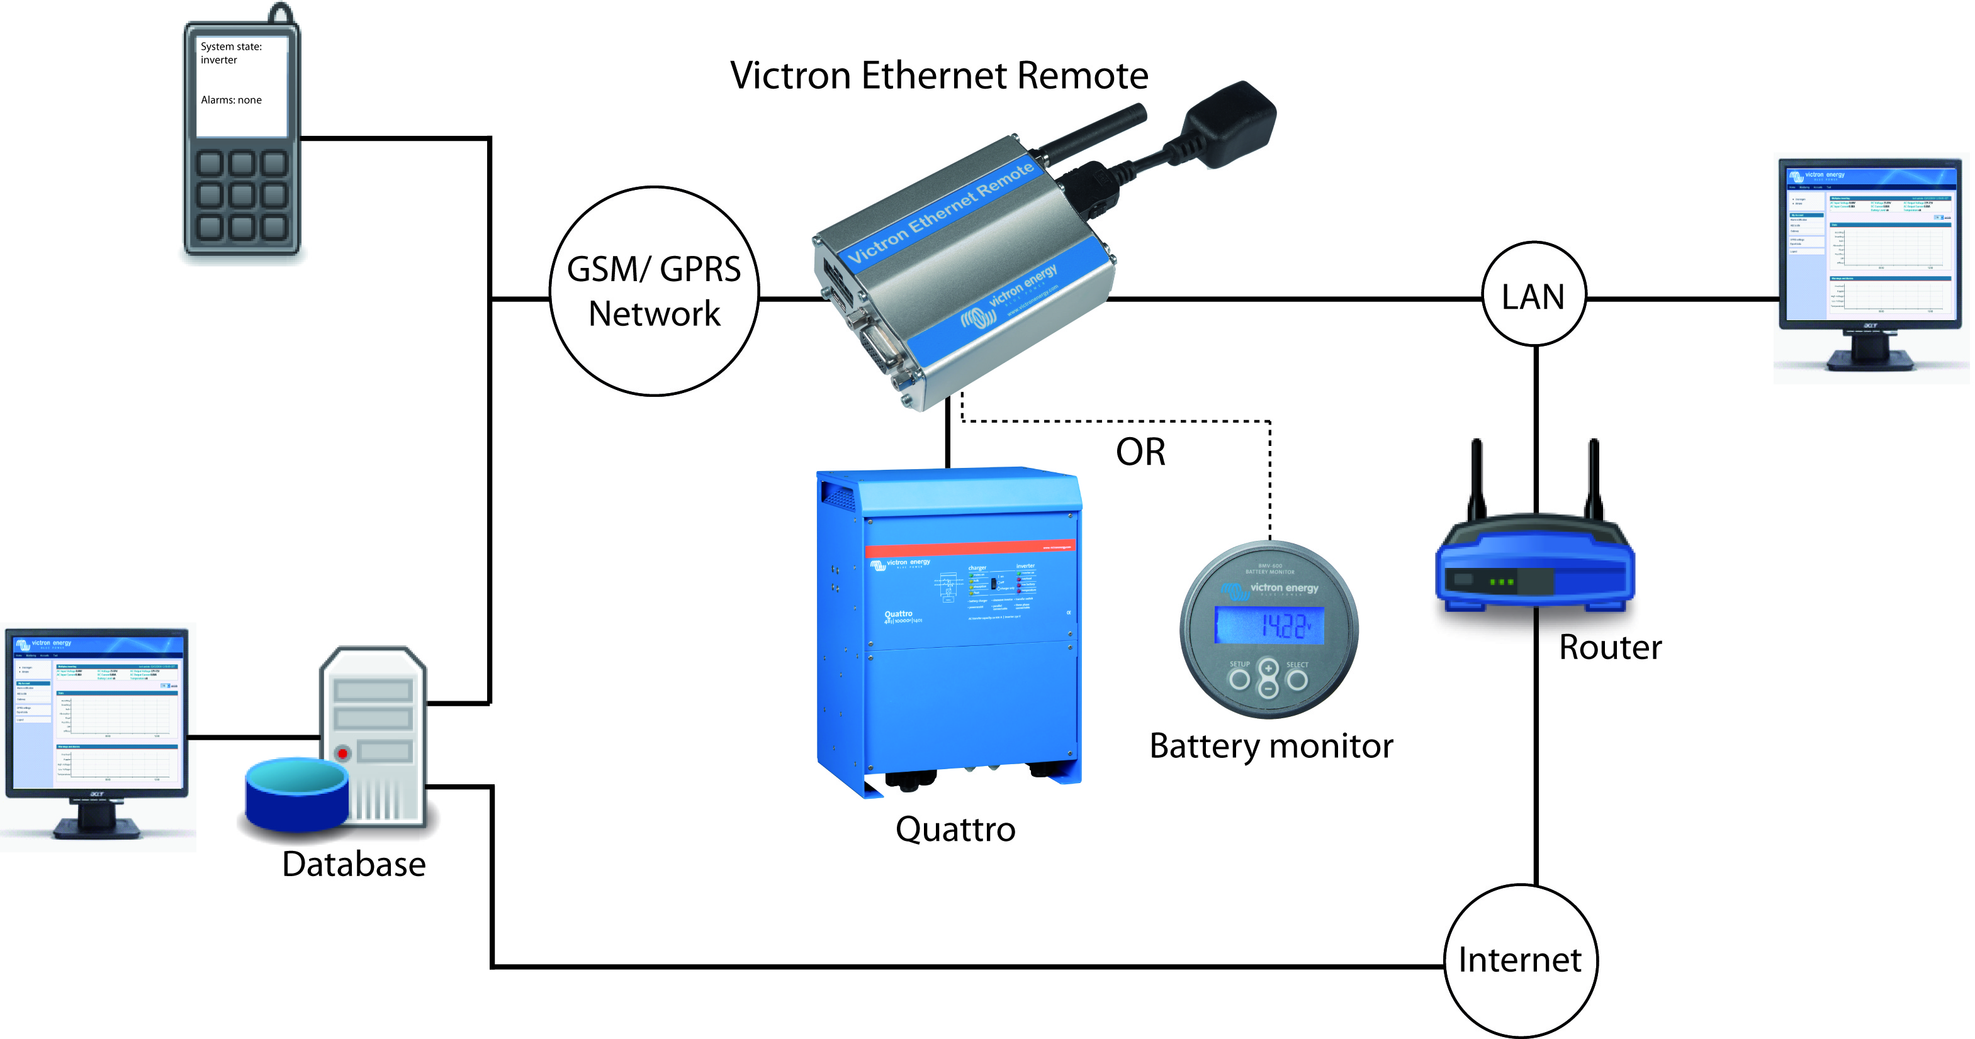
Overview - Victron Ethernet Remote

Slide 5
System schematics
There are four main different configurations possible:
VGR with BMV and/or VE.Bus
VGR with BMV and/or VE.Bus and IO Extender
VER with BMV
VER with VE.Bus

Slide 6
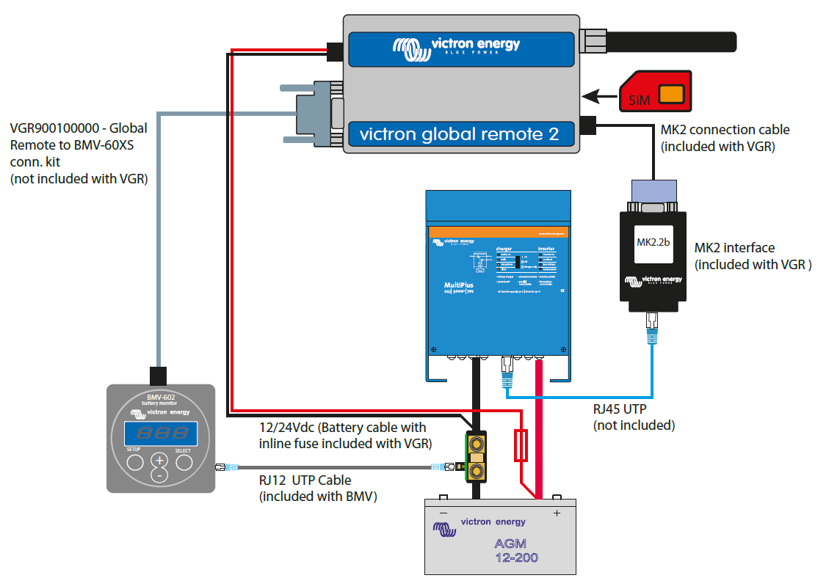
VGR with BMV and/or VE.Bus

Slide 7
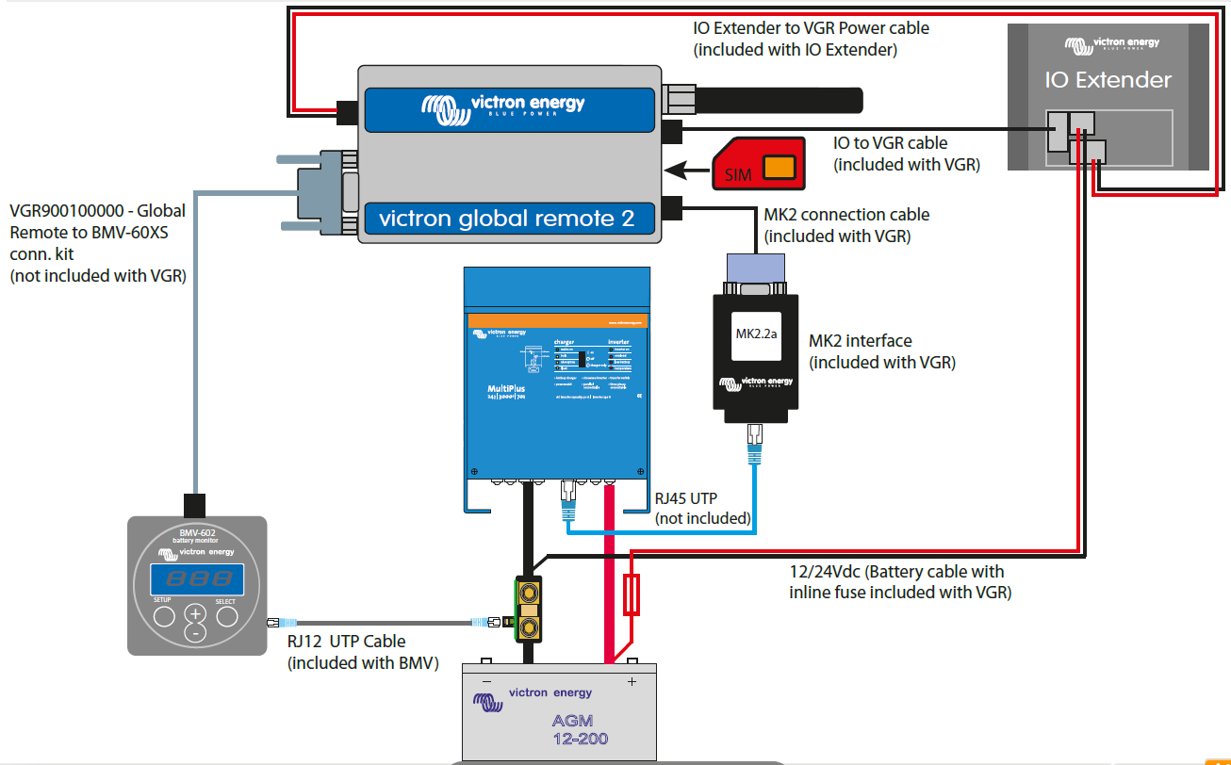
VGR with BMV and/or VE.Bus and IO Ext.

Slide 8
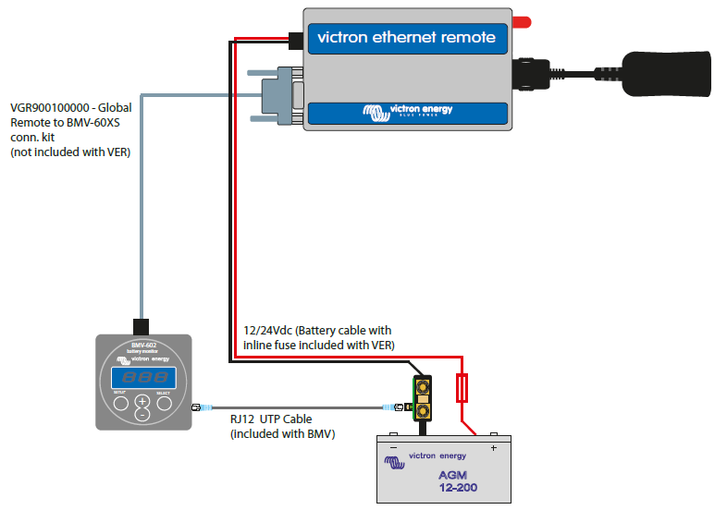
VER with BMV

Slide 9
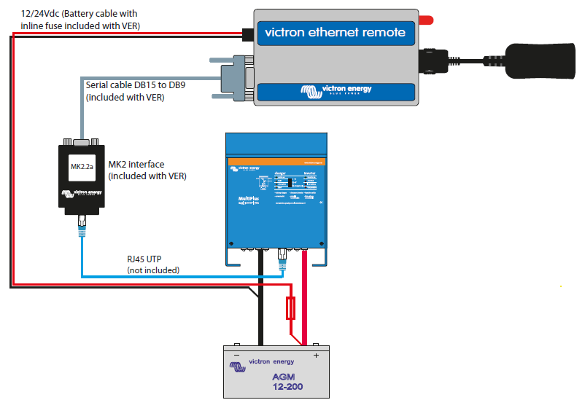
VER with VE.Bus

Slide 10
Text messaging
Send message to VGR:
Reply message:
info
System state: inverter
Alarms: none
Warnings: none
DC: 48.97V 16.71A in
AC in: 0.0V 0.0A 0.0Hz
AC out: 229.9V 3.8A 60Hz
Battery: 26.6V, -017A
Level: 98%, -8Ah
TTG: 240h
Information from Multi
Information from BMV

Slide 11
Text messaging – IO Extender
Send message to VGR:
Showing the IO Extender status
Reply message:
io
IO
OUT1: open
OUT2: open
IN1: open
IN2: open
IN3: closed
Temperature: 39C/102F

Slide 12
Text messaging – IO Extender
Send message to VGR:
Closing one of the two contacts. To start, for example, a generator.
Reply message:
output 1 closed
IO
OUT1: open
OUT2: closed
IN1: open
IN2: open
IN3: closed
Temperature: 39C/102F

Slide 13
Text messaging – gsm network status
Send message to VGR:
Reply message:
gsm
GSM
imei: 354662030005820
sim: OK
signal: -67dB
ber: 0
network: home (Vodafone ES)
SMS from: +31646077489
60dB is full signal
113dB is no signal

Slide 14
Online portal
The Victron Global Remote can log information to our online portal.
Necessary: a working internet connection:
Victron Global Remote: GPRS
Victron Ethernet Remote: Ethernet / LAN

Slide 15
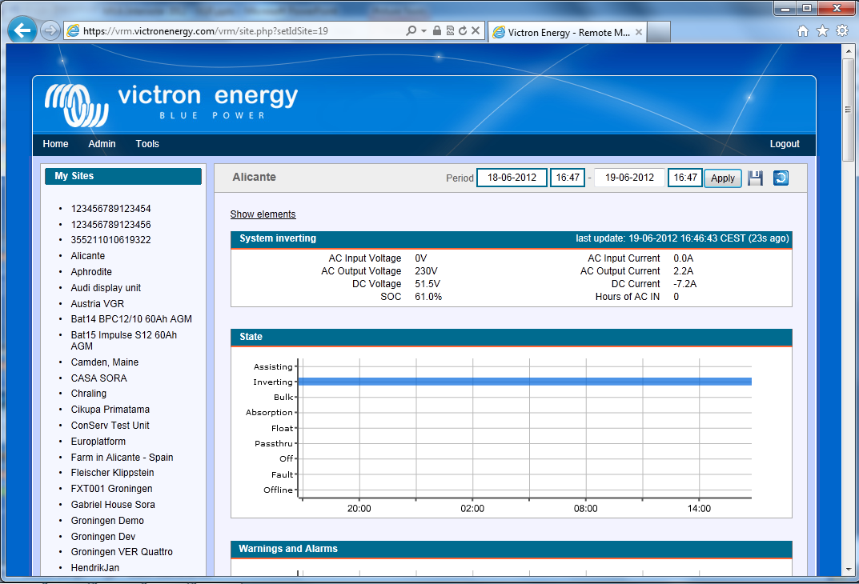
Online portal
https://vrm.victronenergy.com
Demo account: demo@victronenergy.com / vrmdemo

Slide 16
Online portal: GPRS
Get the GPRS status:
Reply message:
Victron Global Remote2: A GPRS Connection is necessary to send the information to the online database.
Victron Ethernet Remote: It will send the information via the LAN. The LAN needs to have internet access.
gprs
GPRS
user: vodafone
pass: vodafone
apn: office.vodafone.nl
state: connected
ip: 109.32.239.49
Necessary to log information to the website

Slide 17
Online portal: GPRS configuration
To configure GPRS, you need the following information from your telecom provider:
APN Required
Username Optional
Password Optional
Proxy address and port Optional
To find this information, you can also search Google. For example search for “GPRS Vodafone APN”. After looking around you will find the following information:
APN: live.vodafone.com
Username: vodafone
Password: vodafone

Slide 18
Online portal: GPRS Configuration
Configuration with APN only:
Reply message:
gprs apn live.vodafone.com on
GPRS
user: username
pass: password
apn: live.vodafone.com
state: connected
ip: 109.32.239.49
Configuration with APN and user
Reply message:
gprs apn live.vodafone.com user vodafone pass vodafone on
GPRS
user: vodafone
pass: vodafone
apn: live.vodafone.com
state: connected
ip: 109.32.239.49

Slide 19
Online portal: GPRS Configuration
Some providers also use a proxy. One example is KPN in the Netherlands.
Configuration with proxy:
Reply message:
gprs apn portalmmm.nl proxy 10.10.100.20 port 5080 on
GPRS
user: username
pass: password
apn: portalmmm.nl
proxy: 10.10.100.20
port: 5080
state: connected
ip: 109.32.239.49
To remove the proxy configuration:
gprs proxy #
GPRS
user: username
pass: password
apn: portalmmm.nl
state: connecting

Slide 20
Online portal: log interval
Send message to VGR:
Log interval configuration. And info when the last data was pushed to the database (https://vrm.victronenergy.com)
Very useful to check of the gprs connection is OK!
Reply message:
log
LOG
Period: 5min
Extra: off
Last log: 1 minutes 3 seconds ago

Slide 21
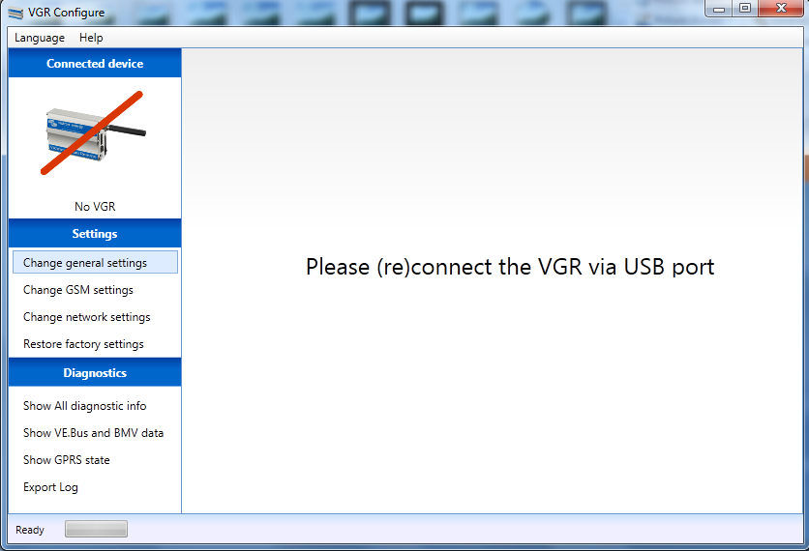
VGR Configure software
Necessary to configure Victron Ethernet Remote, since you cannot send text messages to it, unless you put a sim-card in the Ethernet Remote.
Available for download on our website

Slide 22
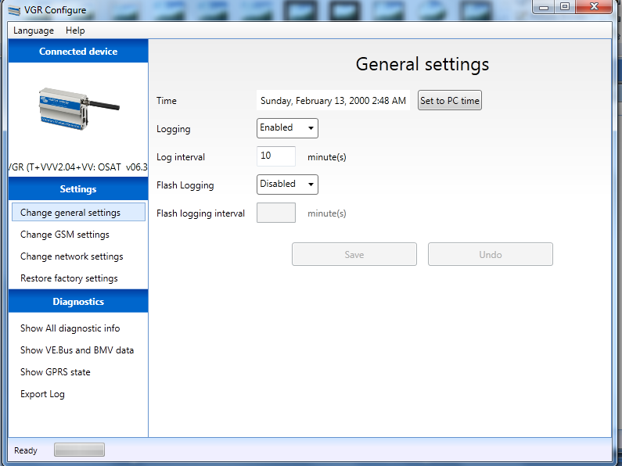
VGR Configure software
General Settings:

Slide 23
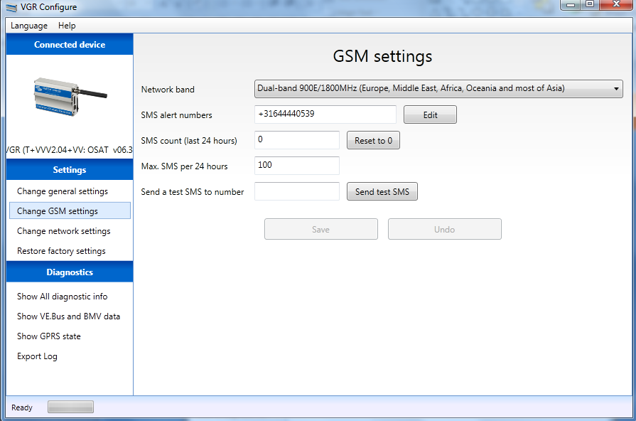
VGR Configure software
GSM settings:

Slide 24
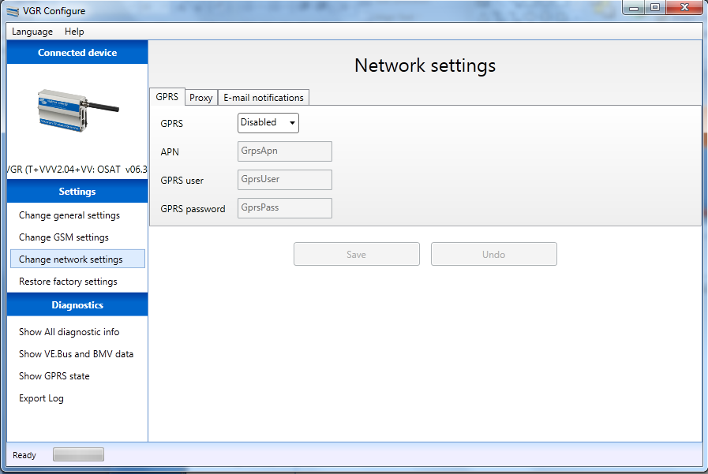
VGR Configure software
Network settings:

Slide 25
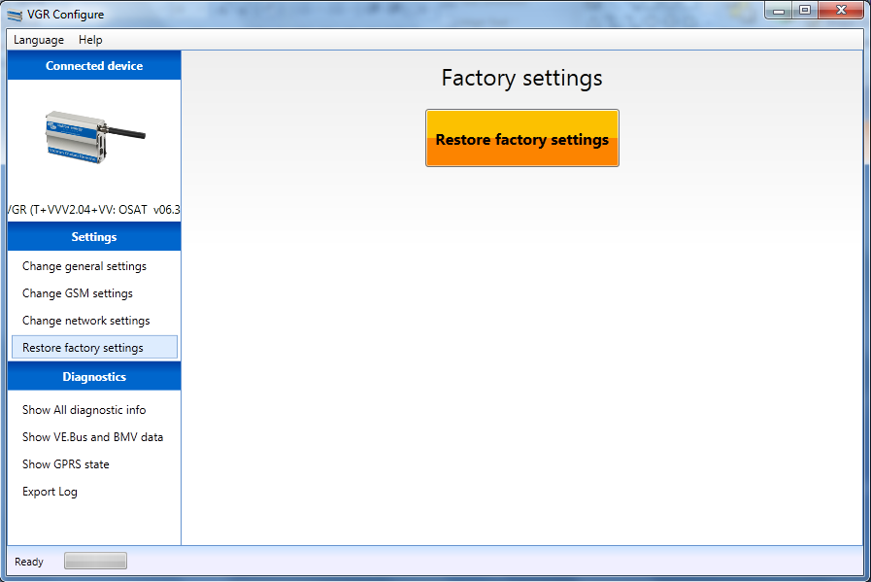
VGR Configure software
Reset to factory settings:

Slide 26
Remote VEConfigure
Change VEConfigure settings over the air
Can be done with the Victron Global Remote 2 and the Victron Ethernet Remote
This is not possible with old Global Remote’s (“Victron Global Remote”)
Make sure to use the latest version of VEConfigure2
See also the manual on our website at the VGR and VER pages:
“Manual – Remote VEConfigure”.

Slide 27
Remote VEConfigure – procedure example
1. Read settings
2. Go to the VRM website and download the .VSC file
3. Change the settings in VEConfigure
4. Upload them back to the website
veconf read
Veconf in progress…
Reading .vsc for dev 1 is succeeded

Slide 28
Remote VEConfigure – procedure example
5. Write settings
Finished! Now the VE.Bus system has been updated with the new settings made.
veconf write
Veconf in progress…
Writing .vsc for dev 1 succeeded

Slide 29
Remote VEConfigure – procedure example
How can we found out how many devices are in a system?
veconf devnum
Number of devs is 1!

